Slide 1
Display Systems Hardware
Advisor and Messenger Overview
897-13 On-Board Monitoring Systems and Software

Slide 2
Agenda
Review Advisor Hardware
Review Messenger Hardware
Review Major Differences
Review Instrument Cluster Hardware
Questions

Slide 3
Agenda
Review Advisor Hardware
Review Messenger Hardware
Review Major Differences
Review Instrument Cluster Hardware
Questions

Slide 4
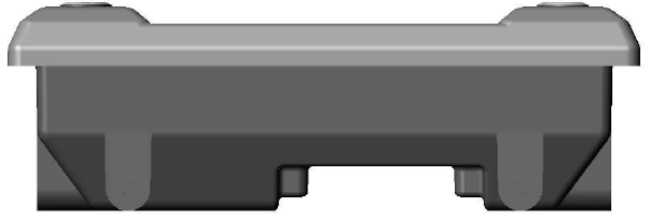
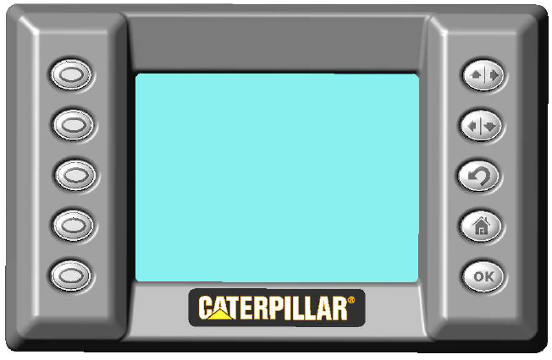
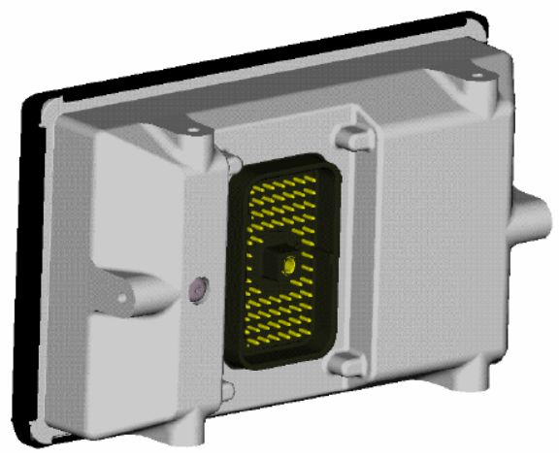
Review Advisor Hardware
Advisor Hardware Pictures

Slide 5
Review Advisor Hardware
Power
  9 – 32 VDC Main supply input
    Keyswitch override
    Battery diagnostic
  11 VDC Instrumentation supply output
    With diagnostic
  8 VDC Sensor supply
    With diagnostic
Screen
  320 x 240 pixel monochrome LCD
  Contrast and backlight control

Slide 6
Review Advisor Hardware
Processor
  Motorola 68376 32-bit Integer Microprocessor
  24 MHz
  Utilize A3 processor architecture
Memory
  Flash: 1 MB or 2 MB
    norm 1 MB development, 2 MB production
  SRAM: 256 KB or 1 MB (norm 1 MB)
  EEPROM: 32 KB
  Video RAM: 256 KB

Slide 7
Review Advisor Hardware
Operator Input
  10 integrated buttons with tri-color LED indicators and backlights (5 per side)
    Tri-color LED indicators are dimmable
    Backlights are not dimmable
  External keypad interface
Data Links
  Cat Data Link (CDL)
  CAN 2.0B/J1939 (2 ports but we only use Port 1)
  RS-232 (not used)

Slide 8
Review Advisor Hardware
High Side Driver
  2 drivers
  500 mA driver with diagnostics
    Diagnostic test lines are tied together for both drivers
  Uses
    Horn or Alarm
    Lamp or LED
      LEDs can be used but diagnostics usually have to be disabled due to the LED’s high impedance (looks like open circuit)

Slide 9
Review Advisor Hardware
Inputs
  Keyswitch
  8 Freq/PWM/STG
  4 Analog/STG
  1 R-Term (alternator)
  1 STB
STG = Switch to Ground
STB = Switch to Battery

Slide 10
Review Advisor Hardware
Other Features
  Internal heater
  Internal temperature sensor (thermistor)
  Operating Temp: -40 to +85 deg C
  70-pin AMP connector
  UFO (Universal Flash Override) Capable
  EC-1 compliance according to hardware specification

Slide 11
Agenda
Review Advisor Hardware
Review Messenger Hardware
Review Major Differences
Review Instrument Cluster Hardware
Questions

Slide 12
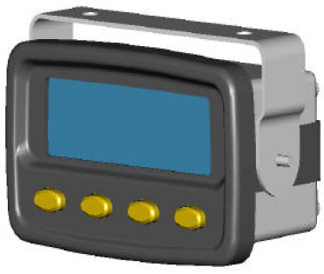
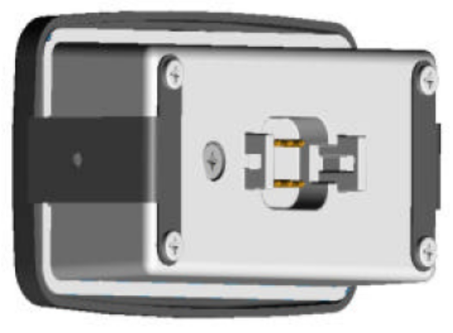
Review Messenger Hardware
Messenger Hardware Pictures

Slide 13
Review Messenger Hardware
Power
  9 – 32 VDC Main supply input
    Keyswitch override
    Battery diagnostic
Screen
  240 x 64 monochrome LCD
  Contrast and backlight control
Operator Input
  4 integrated buttons

Slide 14
Review Messenger Hardware
Processor
  Motorola 68376 32-bit Integer Microprocessor
  24 MHz
  Utilize A3 processor architecture
Memory
  Flash: 512 KB or 1 MB (norm 1 MB)
  SRAM: 128 KB or 512 KB (norm
  512 KB)
  EEPROM: 32 KB

Slide 15
Review Messenger Hardware
Data Links
  Cat Data Link (CDL)
  American Trucking Association (ATA)
    J1708
    On-Highway truck only
  CAN 2.0B/J1939
Note: CDL and ATA cannot be used at the same time – they use the same pins

Slide 16
Review Messenger Hardware
Inputs
  PWM
    Normally used for external LCD dimming control
Other Features
  Internal heater (in development)
  Internal temperature sensor (thermistor)
  Operating Temp: -40 to +85 deg C
  8-pin Deutsch connector
  EC-1 Compliance per hardware spec

Slide 17
Agenda
Review Advisor Hardware
Review Messenger Hardware
Review Major Differences
Review Instrument Cluster Hardware
Questions

Slide 18
Review Major Differences
Screen Size
Inputs and Outputs
Data Links
Purpose (target applications)

Slide 19
Agenda
Review Advisor Hardware
Review Messenger Hardware
Review Major Differences
Review Instrument Cluster Hardware
Questions

Slide 20
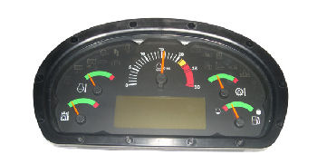
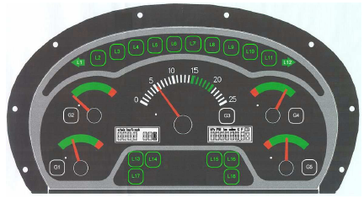
Review Instrument Cluster Hardware
Instrument Cluster Hardware Pictures
Gen I Cluster
Gen II Cluster

Slide 21
Review Instrument Cluster Hardware
Controlled by Display (Advisor or Messenger) on CAN/J1939
Types
  Gen I (1)
    Older, not used on new programs
  Gen II (2)
    Older, not used on new programs
  Gen 2.5
    Full Dimming support
  Gen 2.5b
    Full dimming support with selectable override
Notes:
Usage
Gen 1 – mostly if not completely replaced by Gen 2
Gen 2 – mostly replaced by Gen 2.5 or Gen 2.5b
Dimming
Gen 2 – indicators only dim
Gen 2.5 – indicators and screen dim
Gen 2.5b – allows for override of dimming input

Slide 22
Review Instrument Cluster Hardware
Visual Interface
  4 small gauges
    2 per side
  1 larger gauge
    Center
  18 Indicators
    Two are used for turn signals and are not usually controlled by display
  Segmented LCD Display
    Gen I has two smaller displays
    Gen II has one larger display

Slide 23
Review Instrument Cluster Hardware
Power
  9 - 32 VDC system operation
Data Link Communication
  CAN/J1939
Inputs
  Key Switch Input
  9 STB inputs (Switch to Battery)
    4 to drive indicators
    4 generic inputs
    1 for dimming control
  1 Horn Driver

Slide 24
Review Instrument Cluster Hardware
Other Features
  24-pin Deutsch connector
  Operating Temp
    Normal -40C to + 85C
    Engine & Driveline Components -40C to +120C
    Arctic Applications -54C to upper limit
  EC-1 Compliance per hardware spec

Slide 25
Agenda
Review Advisor Hardware
Review Messenger Hardware
Review Major Differences
Review Instrument Cluster Hardware
Questions

Slide 26

Questions

